Slide 1
Medi-Cal Renewal
September 15, 2023
Adriana Ramos
Sr. Manager, Provider Relations

Slide 2
CalOptima Health Medi-Cal Renewal Goals
Educate members about the renewal process
During Public Health Emergency counties halted the annual renewal eligibility activities
Prepare providers and community-based organizations to support the renewal process
Ensure members take steps to renew coverage
Support members in moving to other coverage if they are no longer eligible for Medi-Cal

Slide 3
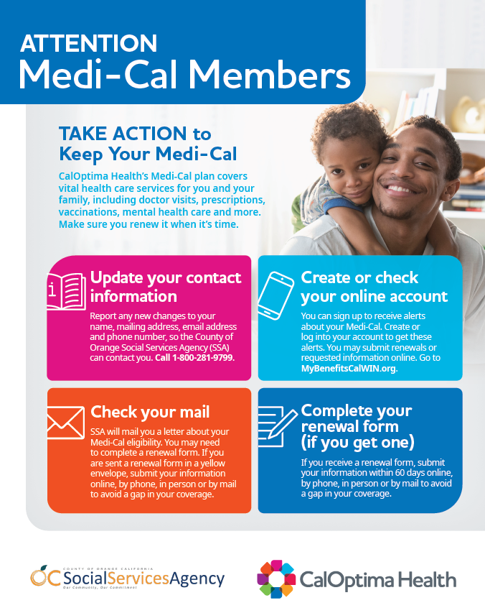
Step 1: Update Contact Information
Members must report any changes
Name
Mailing address
Email address
Phone number
Contact the County of Orange Social Services Agency (SSA)
Online: BenefitsCal.com
Phone: 1-800-281-9799
In person: SSA Regional Offices

Slide 4
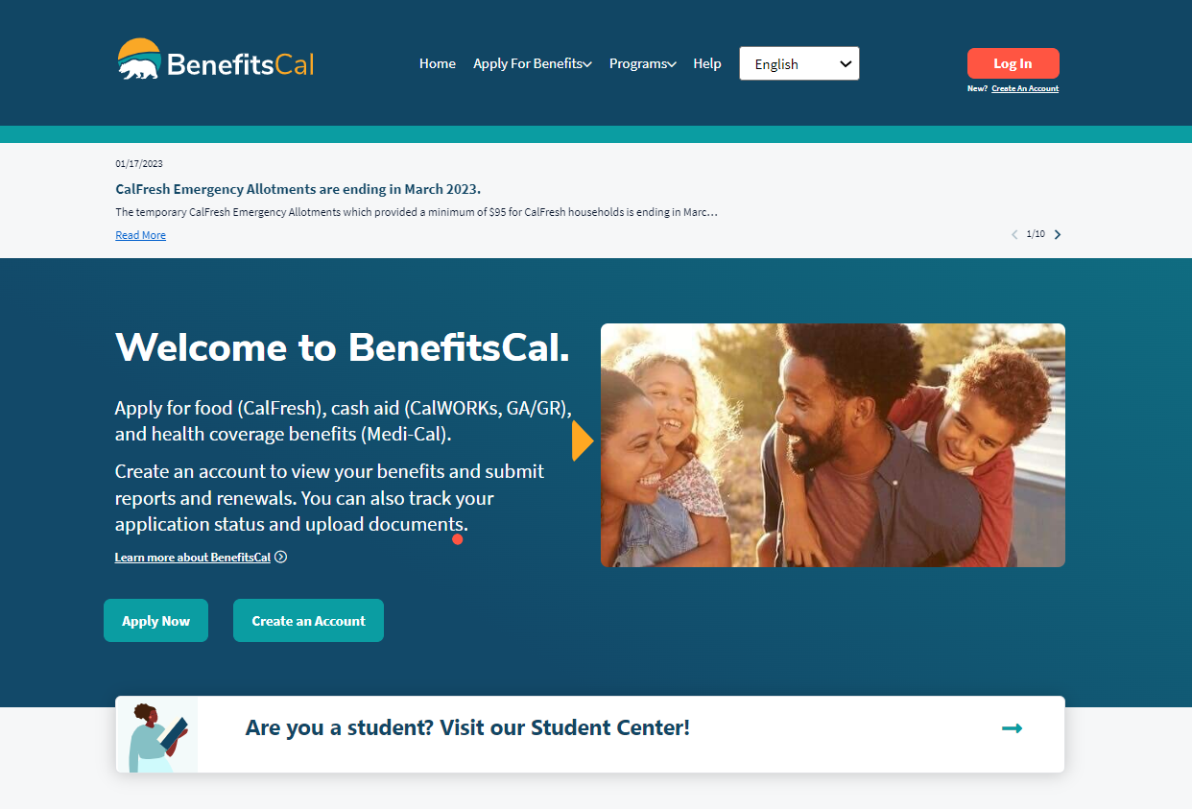
Step 2: Create an Online Account
Members can:
Use new online system
BenefitsCal.com
Create an account
Check their renewal month
Make updates

Slide 5
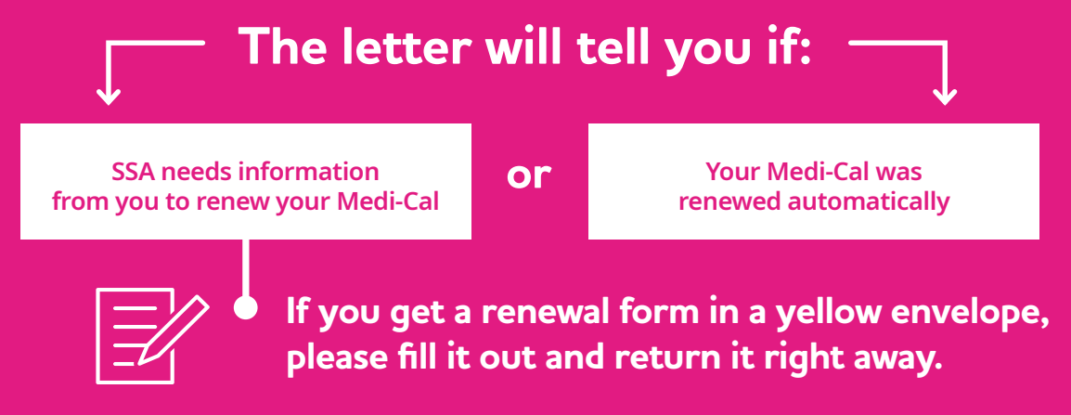
Step 3: Check Mail
Members will get one of two letters in the mail
Automatic renewal letter (regular envelope)
Renewal form (yellow envelope)

Slide 6
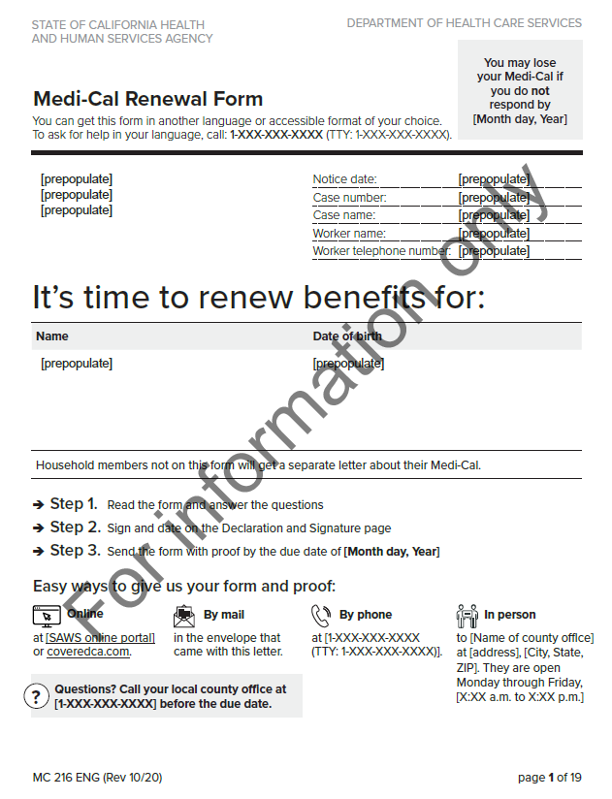
Step 4: Complete Renewal Form
Options available for renewal
Online
By phone
In person
By mail
Members need to act as soon as possible
Due date on the renewal form
No later than 60 days

Slide 7
Member Resources
Direct members to CalOptima Health Customer Service to get help
Call 1-888-587-8088
To learn about community events
Follow social media @caloptima
Facebook
Twitter
Instagram

Slide 8
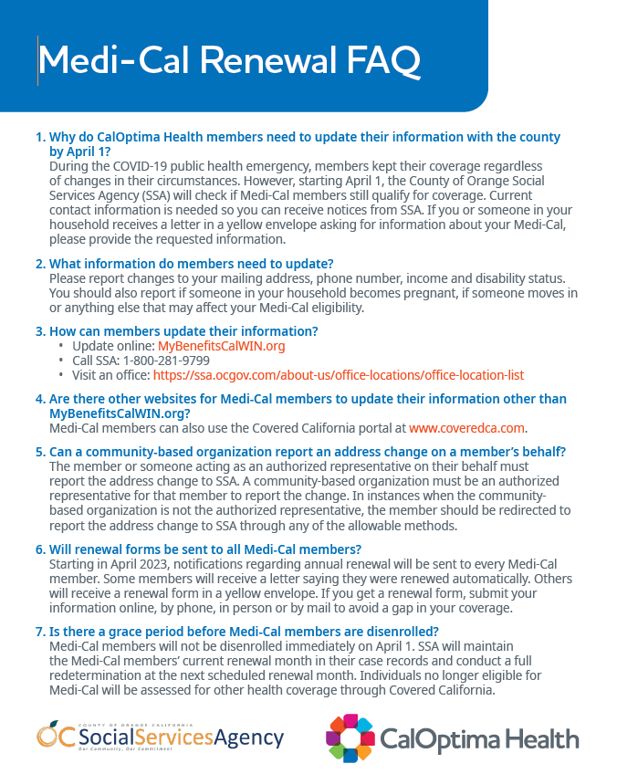
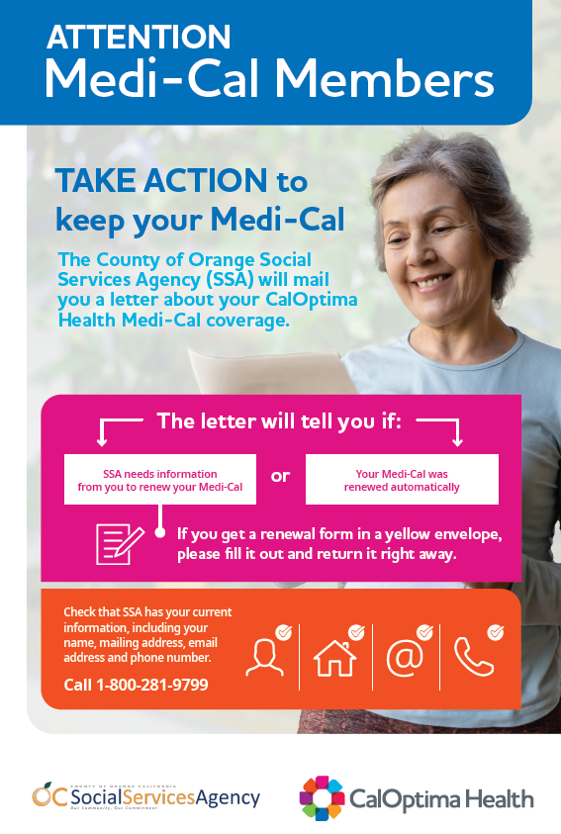
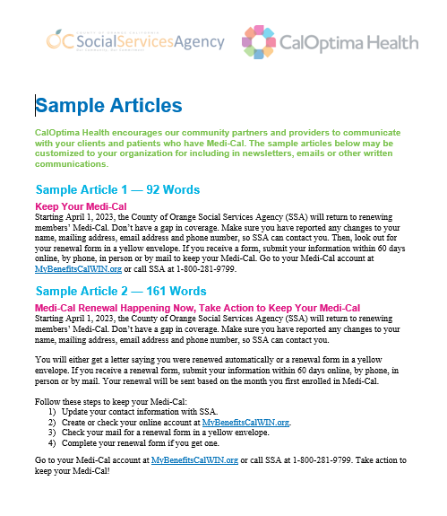
Community Resources
Communications toolkit based on DHCS resources and customized for Orange County in partnership with SSA
Flyer
Poster
FAQ
Sample social media posts
Sample articles for reprinting
Sample texts and image pack
www.caloptima.org/renew
English, Spanish and Vietnamese available

Slide 9
Community-Based Renewal Strategies
In March, Board approved $6 million in renewal support
RFP for community-based navigators
CalOptima Health-funded staff will be deployed in community locations to assist members with renewal forms and navigate those who no longer qualify for Medi-Cal to other health coverage
First group of about 40 navigators is being trained now
Medi-Cal renewal and CalFresh enrollment events
CalOptima Health plans to host six community events focused on renewal and continued CalFresh awareness/enrollment
June and July events drew more than 7,000 people combined

Slide 10
Key Communications Strategies
Tactics for Members | Timing
Spring Medi-Cal Newsletter | April
Spring OneCare Newsletter | May
Texting campaign according to members’ renewal month | Upcoming
Tactics for Providers | Timing
Monthly Provider Update article (email newsletter) | Ongoing
Provider Press article (printed newsletter) | February, July and ongoing
Health Network Forum presentations | March and ongoing

Slide 11
Key Communications Strategies (Cont.)
Tactics for Community-Based Organizations | Timing
Community Toolkit | April
Community Connections newsletter stories | April and later
Speakers Bureau requests for presentations | Ongoing
Tactics for the Public | Timing
Media outreach (Orange County Register) | February and later
Press releases | March and later
Animated video with simple steps for renewal | April
Website homepage banner | March
Social media messages—Facebook, Instagram, Twitter, LinkedIn | Ongoing

Slide 12
Provider Resources
Provider Resource Toolkit
Hospitals and Facilities can customize materials with their own branding
https://www.caloptima.org/en/Renew/Toolkit
https://www.caloptima.org

